Slide 1
Introduction to Multivariate Statistics DATA 366
Week 2: Matrix Algebra
Dr. Zakir

Slide 2
Matrix Algebra Review
Vector
Length of a Vector
Projection of a Vector on Another Vector
Angle between Two Vectors
Inner Product of Two Vectors
Linearly Dependent Vectors
Matrices
Eigenvalues and Eigenvectors of a Matrix
Spectral Decomposition of a Matrix
Positive Definite Matrix

Slide 3
Matrix Algebra Review
Vector
Length of a Vector
Angle between Two Vectors
Inner Product of Two Vectors
Linearly Dependent Vectors
Projection of a Vector on Another Vector
Matrices
Eigenvalues and Eigenvectors of a Matrix
Spectral Decomposition of a Matrix
Positive Definite Matrix

Slide 4
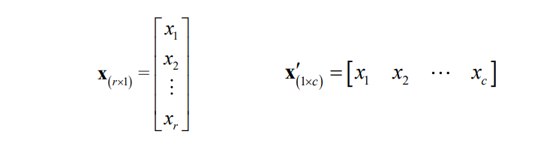
Vectors: A Particular Type of Matrix
Vectors are matrices that have a single row or column
A vector of order r ✕ 1 is a column vector
A vector of order 1 ✕ c is a row vector
Vectors are usually denoted by a lower-case bold letter as column vectors.

Slide 5
Matrix Algebra Review
Vector
Length of a Vector
Angle between Two Vectors
Inner Product of Two Vectors
Linearly Dependent Vectors
Projection of a Vector on Another Vector
Matrices
Eigenvalues and Eigenvectors of a Matrix
Spectral Decomposition of a Matrix
Positive Definite Matrix

Slide 6
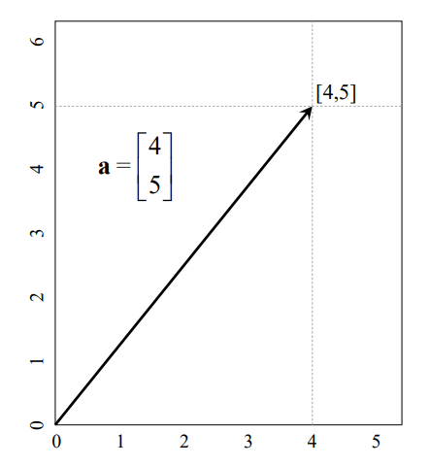
Length/Norm of a Vector
To find the length (magnitude) of the vector , we use the formula

Slide 7
Matrix Algebra Review
Vector
Length of a Vector
Projection of a Vector on Another Vector
Angle between Two Vectors
Inner Product of Two Vectors
Linearly Dependent Vectors
Matrices
Eigenvalues and Eigenvectors of a Matrix
Spectral Decomposition of a Matrix
Positive Definite Matrix

Slide 8
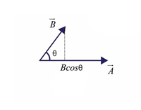
Vector Projection
The shadow of a vector over another vector.
It allows you to determine how one vector influences another in a specific direction.
The projection vector is obtained by multiplying the vector with the Cos of the angle between the two vectors.

Slide 9
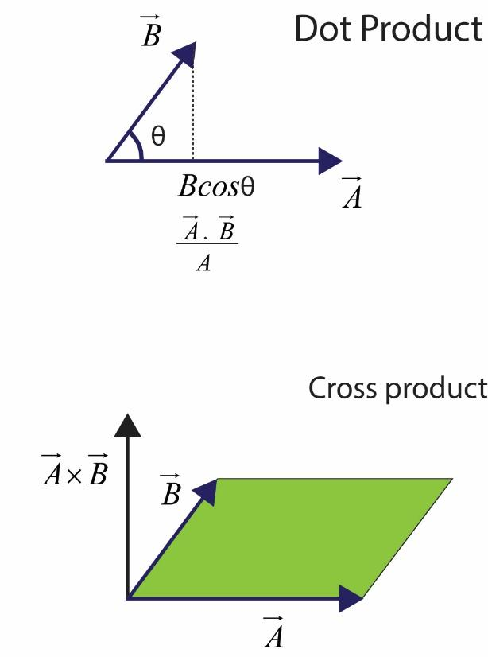
Angle between Two Vectors
Notes:
Dot/scalar product shows the projection of B on A

Slide 10
Properties of dot product
Commutative Property
The order of the vectors in a dot product does not affect the result.
Distributive Property:
The dot product of one vector with the sum of two other vectors is the same as the sum of the dot products of the first vector with each of the other two.

Slide 11
Properties of dot products
Associative Property with Scalar Multiplication:
Property of Magnitude (Self-Dot Product):
Orthogonality:
If two non-zero vectors are orthogonal (perpendicular), their dot product is zero.

Slide 12
Matrix Algebra Review
Vector
Length of a Vector
Projection of a Vector on Another Vector
Angle between Two Vectors
Inner Product of Two Vectors
Linearly Dependent Vectors
Matrices
Eigenvalues and Eigenvectors of a Matrix
Spectral Decomposition of a Matrix
Positive Definite Matrix

Slide 13

Inner product
The generalization of the dot product to an arbitrary vector space is called an “inner product.”
Let V be a vector space. An inner product on V is a rule that assigns to each pair v, w ∈ V a real number such that, for all u, v, w ∈ V and α ∈ R
Notes:
https://web.auburn.edu/holmerr/2660/Textbook/innerproduct-print.pdf
https://users.math.msu.edu/users/gnagy/teaching/05-fall/Math20F/w9-F.pdf

Slide 14
Matrix Algebra Review
Vector
Length of a Vector
Projection of a Vector on Another Vector
Angle between Two Vectors
Inner Product of Two Vectors
Linearly Dependent Vectors
Matrices
Eigenvalues and Eigenvectors of a Matrix
Spectral Decomposition of a Matrix
Positive Definite Matrix

Slide 15
Linearly Dependent Vectors
Linearly dependent vectors are a set of vectors in which at least one vector can be written as a linear combination of the others.
In other words, there exists a set of scalars, not all zero, such that a weighted sum of these vectors equals the zero vector.
Mathematically, a set of vectors {v₁, v₂, ..., v_{n}} in a vector space is said to be linearly dependent if there exist scalars a₁, a₂, ..., a_{n}, not all zero, such that:
a₁*v₁ + a₂*v₂ + ... + a_{n}*v_{n} = 0

Slide 16
Examples of Linear Dependence
Consider the vectors v₁ and v₂ in R². We can see that v₂ is just twice v₁. Therefore, they are linearly dependent since 2*v₁ - v₂ = 0.
As another example, in R³, the vectors v₁ , v₂ , and v₃ are linearly dependent because v₁ + v₂ - v₃ = 0.

Slide 17
Significance of Linear Dependence
Span: If a set of vectors is linearly dependent, it means that the vectors do not all contribute to expanding the span of the space.
Dimension: In a vector space, the maximum number of linearly independent vectors equals the dimension of the space. V₁ and V₂ are independent and dimension=2.
Basis: A set of linearly independent vectors that span the entire space. Linearly dependent vectors cannot form a basis because they are not all needed to span the space.

Slide 18
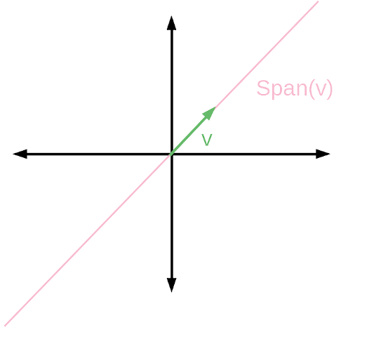
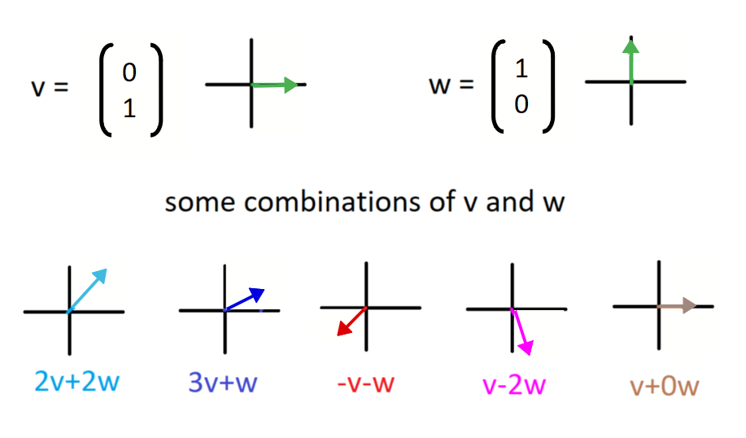

Understand Span
Span(v) is the set of all linear combinations of v, aka the multiples, including (2,2), (3,3),(-2,-2 and so on. In this case Span(v), marked in pink:
Linear combinations of $av+bw$=0 produce different vectors in 2D space. These combinations form the entire 2D plane because $v$ and $w$ are linearly independent.
Notes:
Span the space (you can reach any vector in the space using linear combinations of them).

Slide 19
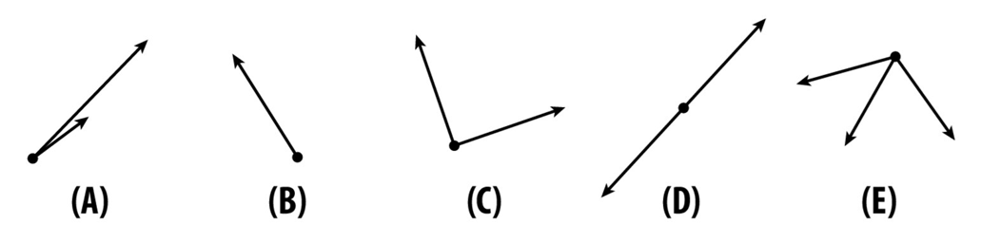
Basis and Span
Which of the following are basis for a 2D plane(n=2)
Basis(Linear Independent): (A), (C) and (E)
If v₁ and v₂ are linearly independent, their span is all of ℝ² (the whole 2D plane).
If they’re linearly dependent, their span is just a line.

Slide 20
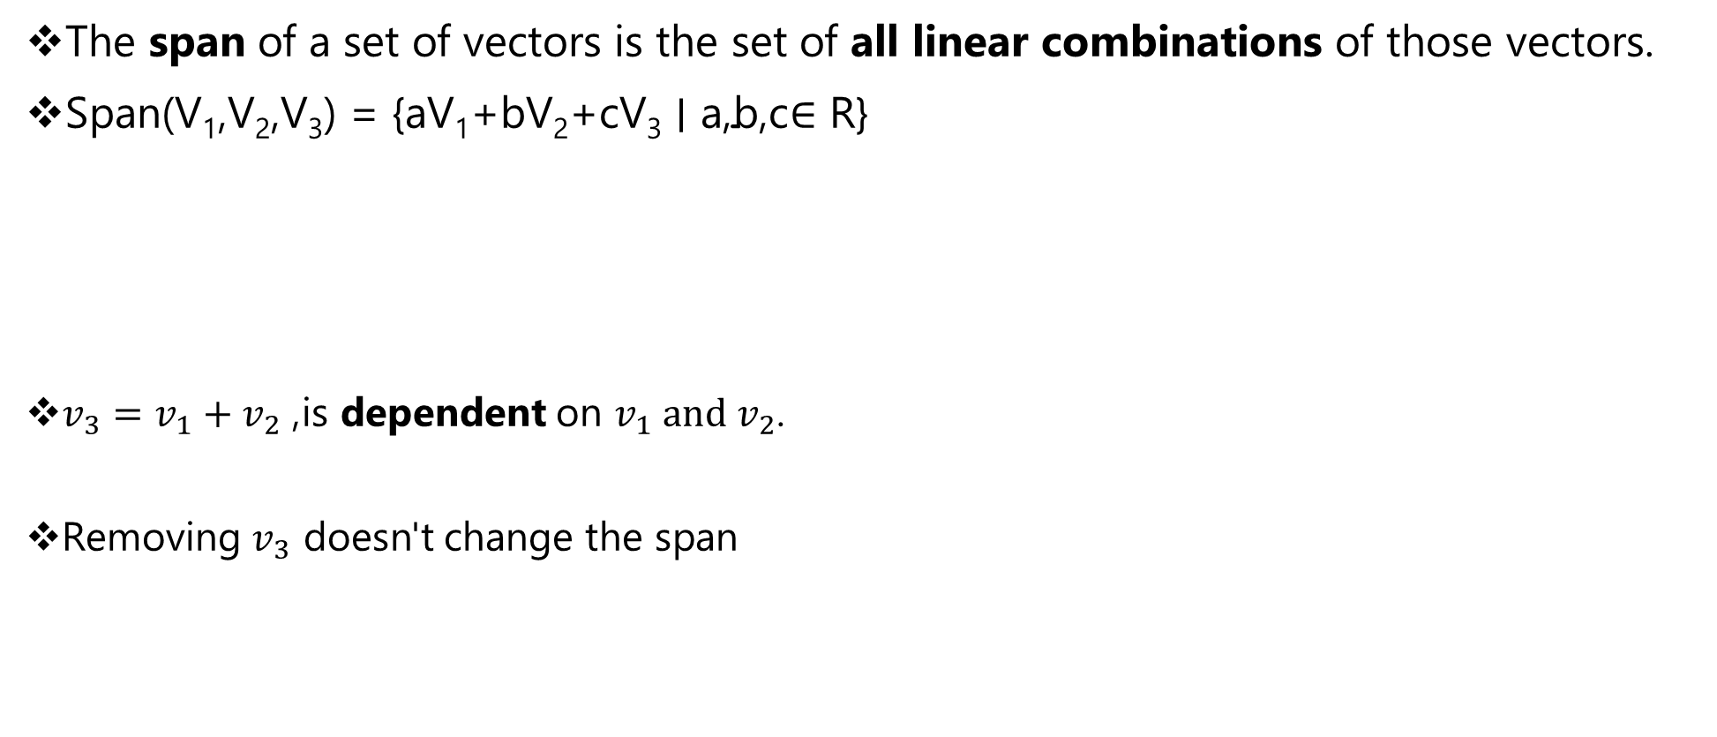
Span: Example
The span of a set of vectors is the set of all linear combinations of those vectors.
$\text{Span}\text{(}\text{V}\text{1}\text{​}\text{,}\text{V}\text{2}\text{​}\text{,}\text{V}\text{3}\text{​}\text{) = \{}\text{aV}\text{1}\text{​}\text{+}\text{bV}\text{2}\text{​}\text{+}\text{cV}\text{3}\text{​ }\text{∣ }\text{a}\text{,}\text{b}\text{,}\text{c}$∈ R}
$v_{3}=v_{1}+v_{2}$, is dependent on $v_{1} and v_{2}$.
Removing $v_{3}$ doesn't change the span
Notes:
Class A and B, C and D

Slide 21
Detecting Linear Dependence
There are several methods to determine if a set of vectors is linearly dependent:
Matrix Determinant: For a set of vectors in R^{n}, if the determinant of the matrix formed by placing the vectors as columns is zero, the vectors are linearly dependent.
Row Reduction: If the matrix formed by the vectors has a row of zeros after row reduction, the vectors are linearly dependent.
Rank: If the rank of the matrix (the maximum number of linearly independent row or column vectors) is less than the number of vectors, then the vectors are linearly dependent.

Slide 22

Matrix Determinant
If the determinant of the matrix formed by placing the vectors as columns is zero, the vectors are linearly dependent.
Since $\text{det}\left(A\right)=0$, the three vectors are linearly dependent.

Slide 23
Row Reduction: Gaussian elimination
If the matrix formed by the vectors has a row of zeros after row reduction, the vectors are linearly dependent.
Row swapping
Row multiplication : Multiply a row by a nonzero scalar.
Row addition : Replace one row by the sum of itself and a multiple of another row.
Notes:
A pivot is the first non-zero number in a row of a matrix (from left to right) after performing row operations to get the matrix into row echelon form.

Slide 24
Rank
Rank: If the rank of the matrix (the maximum number of linearly independent row or column vectors) is less than the number of vectors, then the vectors are linearly dependent.
Number of Nonzero Rows=Rank
Notes:
A pivot is the first non-zero number in a row of a matrix (from left to right) after performing row operations to get the matrix into row echelon form.

Slide 25
Matrix Algebra Review
Vector
Length of a Vector
Projection of a Vector on Another Vector
Angle between Two Vectors
Inner Product of Two Vectors
Linearly Dependent Vectors
Matrices
Eigenvalues and Eigenvectors of a Matrix
Spectral Decomposition of a Matrix
Positive Definite Matrix

Slide 26
Use of Matrices in MVS
Multivariate models can be expressed compactly using matrices
Matrices organizes of large numbers of observations, variables, and parameters
Understanding matrices allows us to better understand core statistical model.

Slide 27
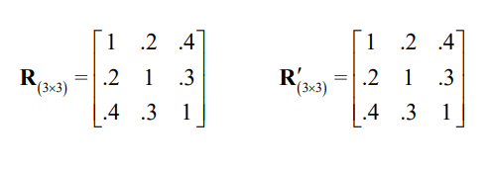
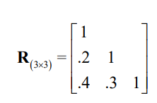
Symmetric Matrices
A square matrix A is considered symmetric if A= A’ .
Important cases: covariance, correlation, and distance matrices
A symmetric matrix can be represented as “lower-triangular form” to omit the redundant elements.
Notes:
In an upper triangular matrix, all entries below the diagonal are zero.

Slide 28
Matrix Algebra Review
Vector
Length of a Vector
Projection of a Vector on Another Vector
Angle between Two Vectors
Inner Product of Two Vectors
Linearly Dependent Vectors
Matrices
Eigenvalues and Eigenvectors of a Matrix
Spectral Decomposition of a Matrix
Positive Definite Matrix

Slide 29
Eigenvalues and eigenvectors
An eigenvector(v) is a non-zero vector that, which satisfy the following equation.
ʎ is the scalar factor by which the eigenvector is stretched, shrunk, or reversed.
Eigenvalues are found by solving det(A - λI) = 0.
Notes:
https://math.mit.edu/~gs/linearalgebra/ila5/linearalgebra5_6-1.pdf
https://youtu.be/9CT0jnem4vM?si=zL4OFxV427oxPtKD

Slide 30
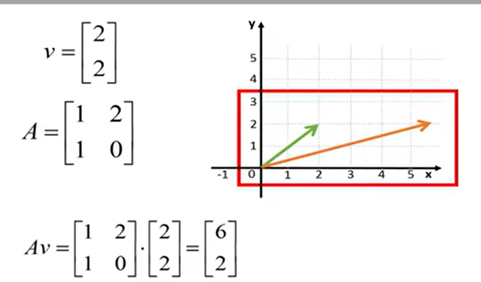
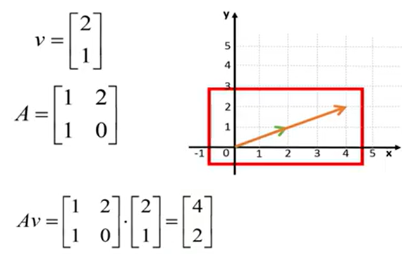
Examples of Eigenvector and Eigenvalue
Not an Eigenvectors
An Eigenvector
ʎ=2
Eigen Value: The Eigenvalue tells us how much a given vector is changed by multiplying it with an Eigen value

Slide 31
Matrix Size vs Eigenvalues/Eigenvectors
Order of Matrix | Square? | Eigenvalues Exist? | Number of Eigenvalues | Number Linearly Independent Eigenvectors
1×1 | Yes | Yes | 1 | 1
2×2 | Yes | Yes | 2 | 1-2
3×3 | Yes | Yes | 3 | 1–3
2×3 | No | No | 0 | 0
3×2 | No | No | 0 | 0
4×4 | Yes | Yes | 4 | 1–4
5×3 | No | No | 0 | 0

Slide 32
Eigenvalues and eigenvectors
Find the Eigenvalues of A
The corresponding eigenvalue can be found by solving (A−λI)v=0 at each eigenvalue λ.

Slide 33
Find the Eigen Vector
Given a square matrix and its eigen values ʎ₁=4 and ʎ₂=-3

Slide 34
Matrix Algebra Review
Vector
Length of a Vector
Projection of a Vector on Another Vector
Angle between Two Vectors
Inner Product of Two Vectors
Linearly Dependent Vectors
Matrices
Eigenvalues and Eigenvectors of a Matrix
Spectral Decomposition of a Matrix
Positive Definite Matrix
Notes:
Spectral decomposition of a Matrix

Slide 35
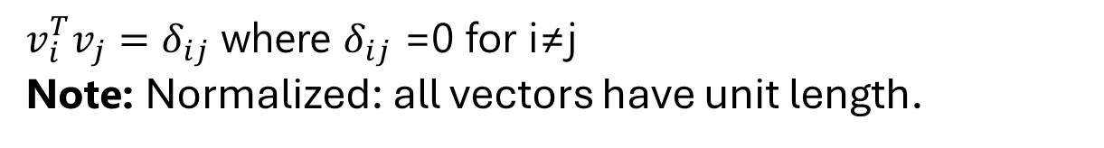
Spectral Decomposition of a Matrix
A symmetric matrix can be decomposed based on its eigenvalues and eigenvectors in a form known as spectral decomposition.
Let A be a symmetric matrix with real components: A=(a_{ij}​)∈R^{n×n}. Since it is a symmetric matrix, A=A^{T}.
The eigenvalues of this matrix are all real numbers. Let the eigenvalues be ʎ₁​, ʎ₂ ​, ⋯ , ʎ_{n}​, and they can be defined in ascending order as follows:
Let the eigenvectors corresponding to each eigenvalue be v₁​,v_{2​},⋯,v_{n}​, then:
The eigenvectors of a symmetric matrix in the case of real numbers form an orthonormal basis in the vector space.
$v_{i}^{T}v_{j}=δ_{ij}$ where $δ_{ij}$ =0 for i≠j
Note: Normalized: all vectors have unit length.
Notes:
https://medium.com/@hiroshi.wayama/linear-algebra-spectral-decomposition-cb72d8f124ad

Slide 36
Spectral Decomposition of a Matrix
Therefore
If we define V=(v₁,v₂,…V_{n}) then hen V^{T}V=I, and V^{T}=V⁻¹, thus VV^{T}=I also holds.

Slide 37
Spectral Decomposition of a Matrix
By focusing on each eigenvalue and calculating, it can be decomposed into a sum as follows:
This is one of the matrix decomposition methods known as spectral decomposition.
Notes:
https://medium.com/@hiroshi.wayama/linear-algebra-spectral-decomposition-cb72d8f124ad

Slide 38

Implementation of Spectral Decomposition in Python
As an example, let’s implement spectral decomposition for the following matrix A using Python:
The eigenvalues need to be calculated, but we will use numpy for this. Since A is a symmetric matrix, numpy.linalg.eigh() can be applied.

Slide 39
Implementation of Spectral Decomposition in Python
# Define matrix A
A = np.array( [ [0, 0, 0, 1, 0, 0, 1], [0, 0, 0, 1, 1, 0, 1], [0, 0, 0, 1, 0, 0, 1], [1, 1, 1, 0, 0, 0, 0], [0, 1, 0, 0, 0, 0, 0], [0, 0, 0, 0, 0, 1, 0], [1, 1, 1, 0, 0, 0, 0], ] )
# Calculate eigenvalues # a represents eigenvalues, v represents eigenvectors a, v = np.linalg.eigh(A)

Slide 40

Implementation of Spectral Decomposition in Python
To verify that the eigenvectors are correct, calculate the following value:
# Reproduction verification _A = v @ np.diagflat(a) @ v.T a2l.to_ltx(np.abs(_A), frmt="{:.0f}", arraytype="pmatrix")

Slide 41
Implementation of Spectral Decomposition in Python
Finally, let’s perform the calculation according to the spectral decomposition equation.
# Verification of reproducibility using spectral decomposition __A = 0 for i in range(len(v)): __A += a[i] * v[:, i : i + 1] @ v[:, i : i + 1].T a2l.to_ltx(np.abs(__A), frmt="{:.0f}", arraytype="pmatrix")

Slide 42

Implementation of Spectral Decomposition in Python
We can see that the eigenvalues and eigenvectors are correctly obtained.
Finally, let’s perform the calculation according to the spectral decomposition equation.

Slide 43
Implementation of Spectral Decomposition in Python
# Verification of reproducibility using spectral decomposition __A = 0 for i in range(len(v)): __A += a[i] * v[:, i : i + 1] @ v[:, i : i + 1].T a2l.to_ltx(np.abs(__A), frmt="{:.0f}", arraytype="pmatrix")
It is confirmed that the original matrix A can be reproduced using the spectral decomposition equation.

Slide 44
Matrix Algebra Review
Vector
Length of a Vector
Projection of a Vector on Another Vector
Angle between Two Vectors
Inner Product of Two Vectors
Linearly Dependent Vectors
Matrices
Eigenvalues and Eigenvectors of a Matrix
Spectral Decomposition of a Matrix
Positive Definite Matrix
Notes:
Spectral decomposition of a Matrix

Slide 45
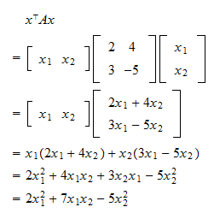
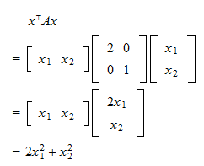
Positive Definite Matrix
A positive definite matrix is a square, symmetric matrix where all its eigenvalues are positive.
For any nonzero real vector x, the product xᵀAx (or x^{T}Ax), which represents a quadratic form, is always positive.

